Slide 1
Azure IoT complete Backend
Build complete backend solution for your IoT Projects in
Microsoft Azure Bret Stateham
Bret.Stateham@Microsoft.com
@BretStateham
https://aka.ms/ingenu2azure https://aka.ms/ingenu2azurecasestudy

Slide 2
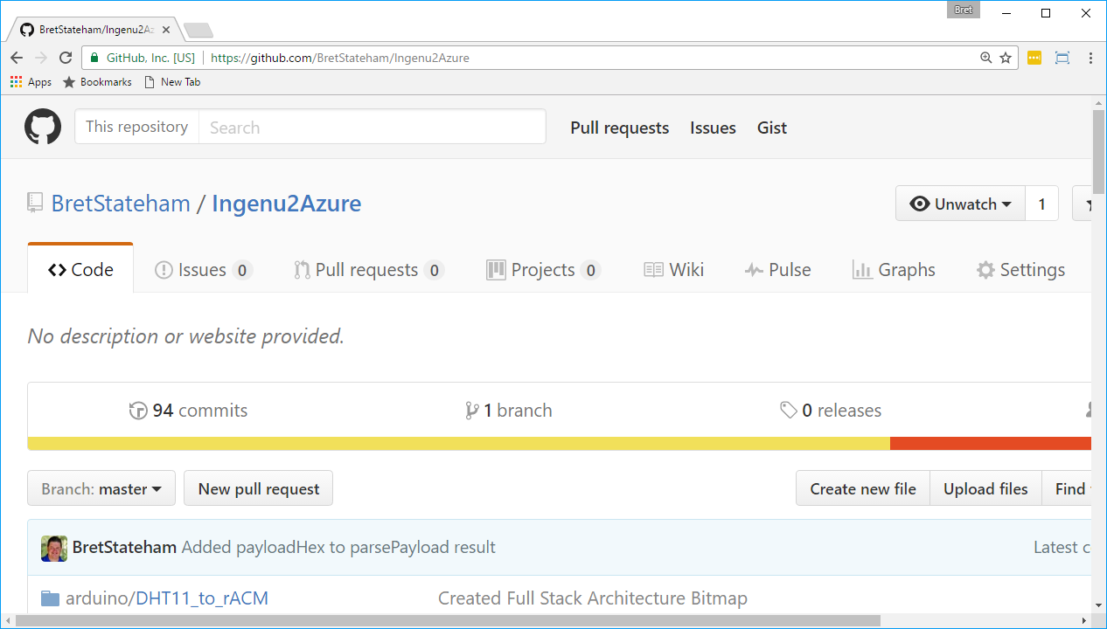
Source code & slides
http://aka.ms/ingenu2azure

Slide 3
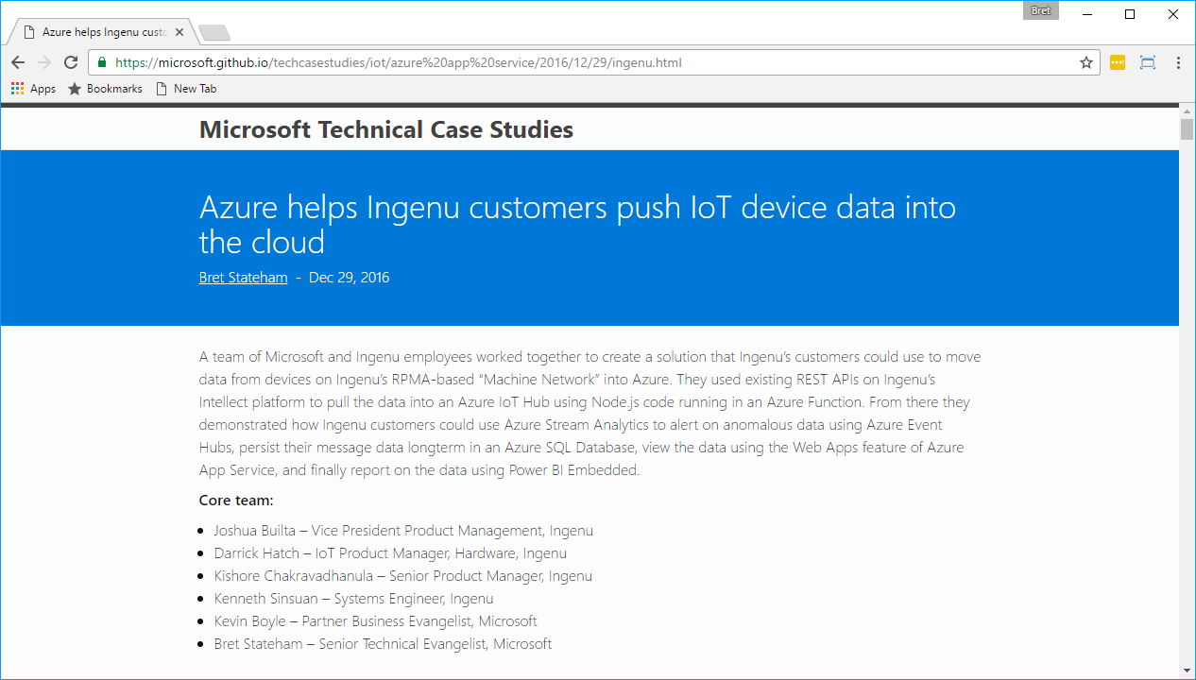
Technical case study
https://aka.ms/ingenu2azurecasestudy

Slide 4
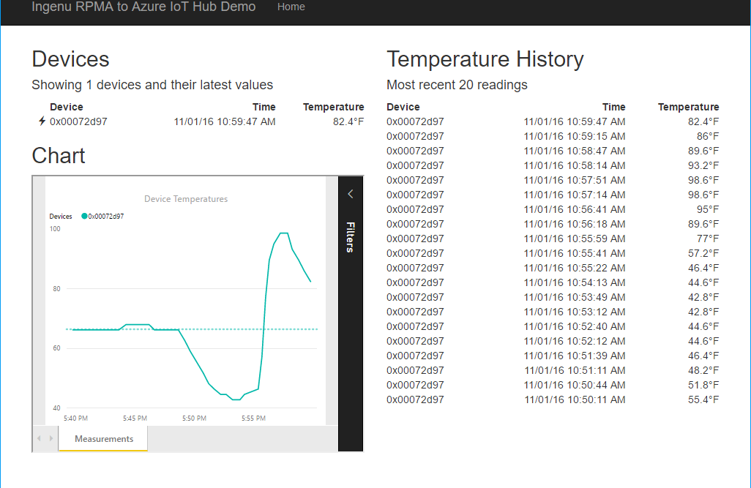


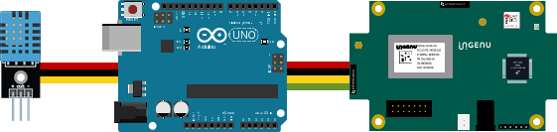
Resource Group <name>group
Power BI Embedded Collection ingenucollection
Power BI Embedded Workspace Dynamic GUID
RENDER
Power BI Report Temperature Chart
Storage Account ingenustorage
App Service Plan ingenuplan
READ/WRITE
Function App ingenufunctions
GET
Web App ingenuweb
QUERY
Function EventHub2IntellectRestJS
Function IntellectRest2IoTHubJs
QUERY
Service Bus Namespace ingenubus
SQL Server ingenusql
RECEIVE
SQL Database
ingenudb
Event Hub
ingenualerts
SEND
OUTPUT
OUTPUT
Stream Analytics Job ingenujob
POST
GET
AZURE
INPUT
RPMA to Azure
Architecture Diagram
IoT Hub ingenuhub
Ingenu Intellect Platform - REST or AMQP
INGENU
BACKHAUL
Ingenu RPMA Access Point
UPLINK
DOWNLINK
FIELD

Slide 5
Resource Group <name>group
Power BI Embedded Collection ingenucollection
Power BI Embedded Workspace Dynamic GUID
RENDER
Power BI Report Temperature Chart
Storage Account ingenustorage
App Service Plan ingenuplan
READ/WRITE
Function App ingenufunctions
GET
Web App ingenuweb
QUERY
Function EventHub2IntellectRestJS
Function IntellectRest2IoTHubJs
QUERY
Service Bus Namespace ingenubus
SQL Server ingenusql
RECEIVE
SQL Database
ingenudb
Event Hub
ingenualerts
SEND
OUTPUT
OUTPUT
Stream Analytics Job ingenujob
POST
GET
AZURE
INPUT
RPMA to Azure
Architecture Diagram
IoT Hub ingenuhub
Ingenu Intellect Platform - REST or AMQP
INGENU
BACKHAUL
Ingenu RPMA Access Point
UPLINK
DOWNLINK
FIELD

Slide 6
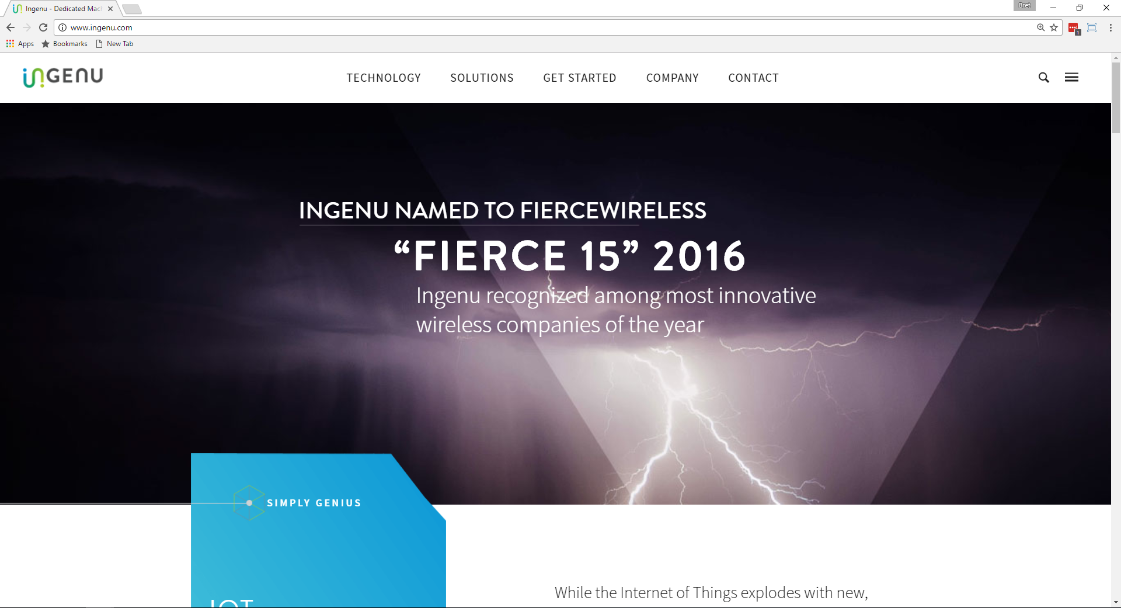
Ingenu & rpma
www.ingenu.com

Slide 7
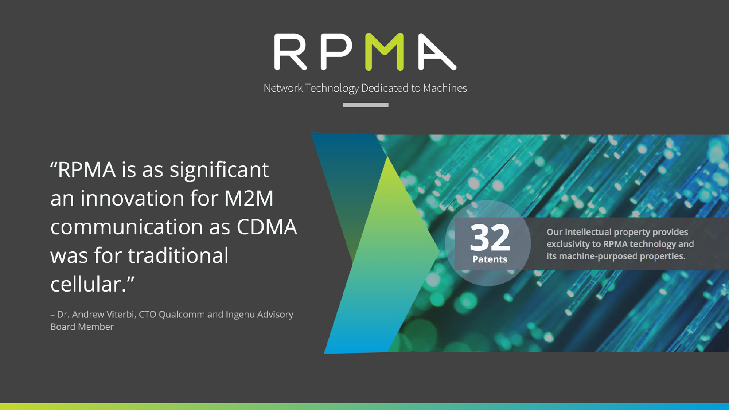

Slide 8
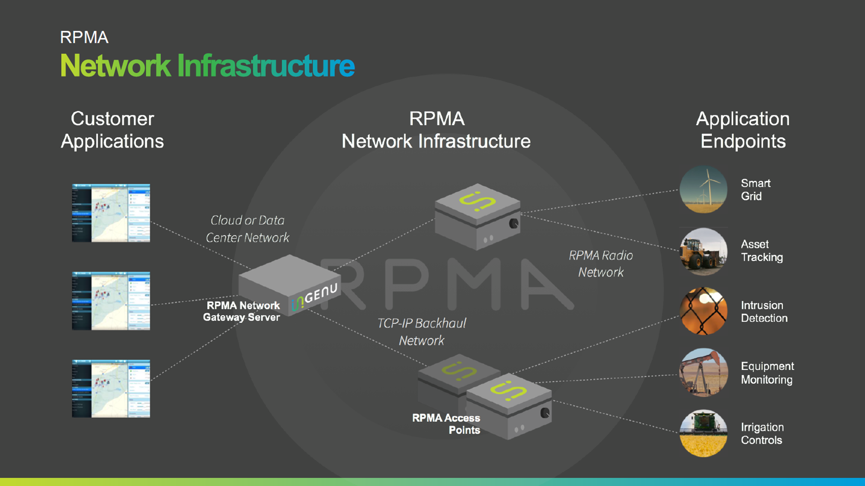

Slide 9
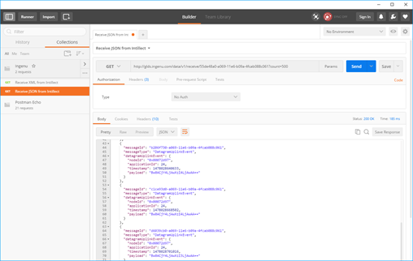
GET
AZURE
RPMA to Azure
Architecture Diagram
Ingenu Intellect Platform - REST or AMQP
INGENU
BACKHAUL
Ingenu RPMA Access Point
UPLINK
FIELD

Slide 10
Pulling device data out of Intellect via REST
https://aka.ms/ingenu2azure https://aka.ms/ingenu2azurecasestudy

Slide 11
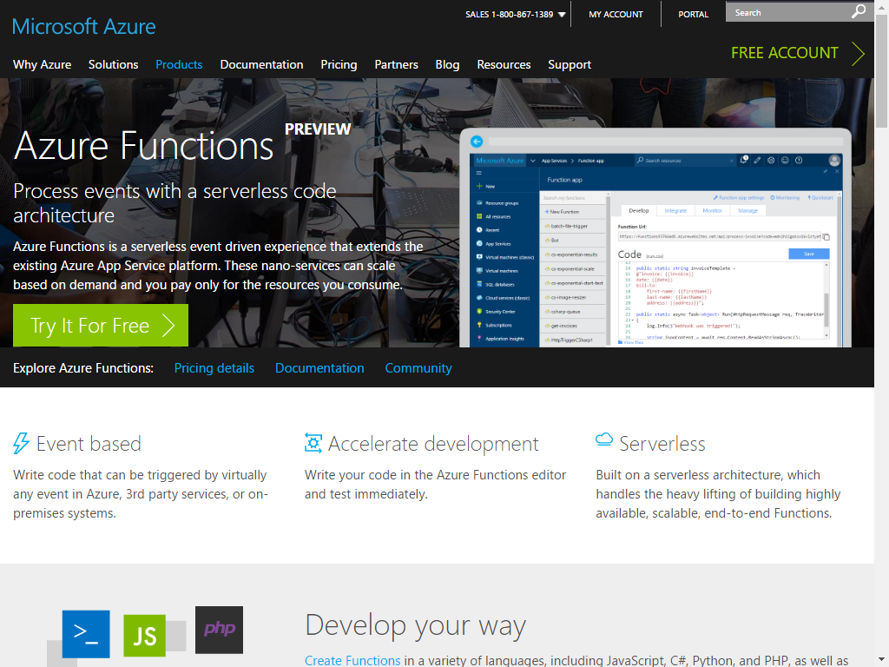
Azure functions
Process events with a serverless code architecture
Azure functions is a serverless event driven experience that extends the existing Azure App Service platform. These nano-services can scale based on demand and you pay only for the resources you consume.
https://aka.ms/ingenu2azure https://aka.ms/ingenu2azurecasestudy

Slide 12
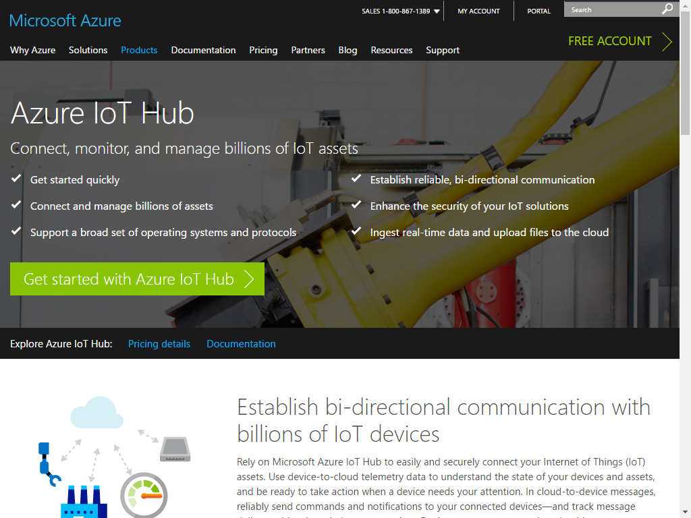
Azure IoT Hub
Establish secure bi-directional communication with billions of IoT devices.
Work with familiar protocols like HTTPS, AMQPs, and MQTTS
Work with familiar languages like C#, C++, JavaScript, Java & Python
https://aka.ms/ingenu2azure https://aka.ms/ingenu2azurecasestudy

Slide 13
Resource Group <name>group
Storage Account ingenustorage
App Service Plan ingenuplan
READ/WRITE
Function App ingenufunctions
Function IntellectRest2IoTHubJs
SEND
GET
AZURE
RPMA to Azure
Architecture Diagram
IoT Hub ingenuhub
Ingenu Intellect Platform - REST or AMQP
INGENU
BACKHAUL
Ingenu RPMA Access Point
UPLINK
FIELD

Slide 14
Demo the Azure Function and IoT Hub
https://aka.ms/ingenu2azure https://aka.ms/ingenu2azurecasestudy

Slide 15
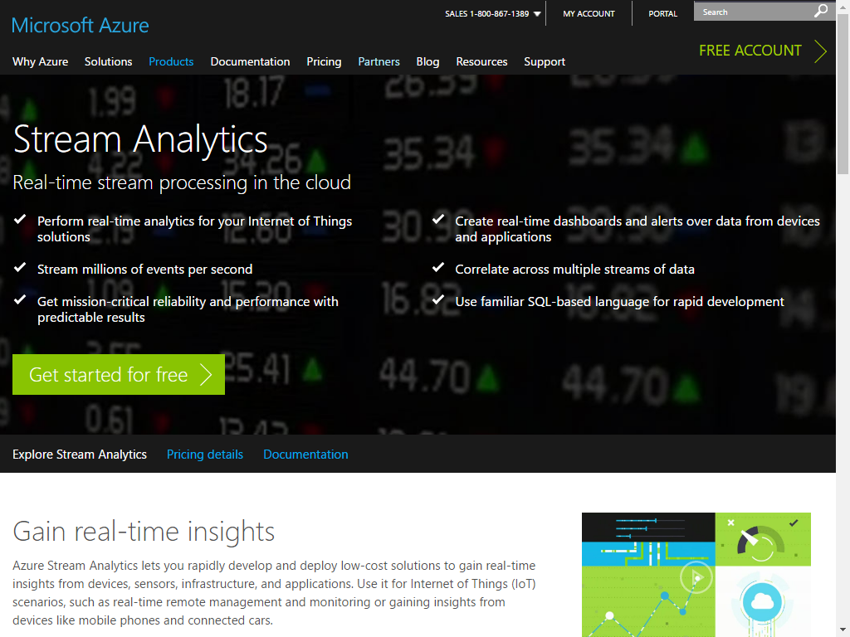
Azure Stream analytics
Real-time stream processing in the cloud.
Perform real-time analytics for your IoT Solutions
Stream millions of events per second
Use familiar SQL-based language for Rapid Development
https://aka.ms/ingenu2azure https://aka.ms/ingenu2azurecasestudy

Slide 16
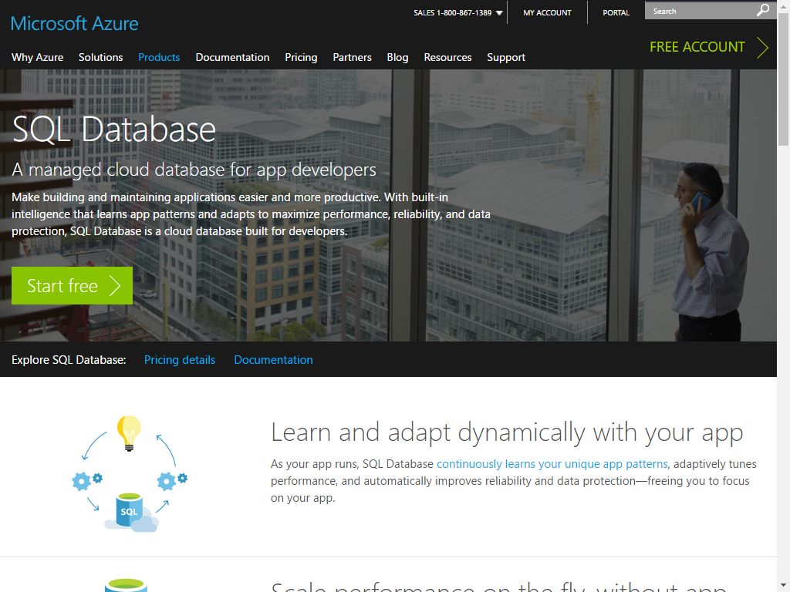
Azure SQL Database
A managed cloud database for app developers
Make building and maintaining applications easier and more productive. With built-in intelligence that learns app patterns and adapts to maximize performance, reliability, and data protection, SQL Database is a cloud database built for developers.
https://aka.ms/ingenu2azure https://aka.ms/ingenu2azurecasestudy

Slide 17
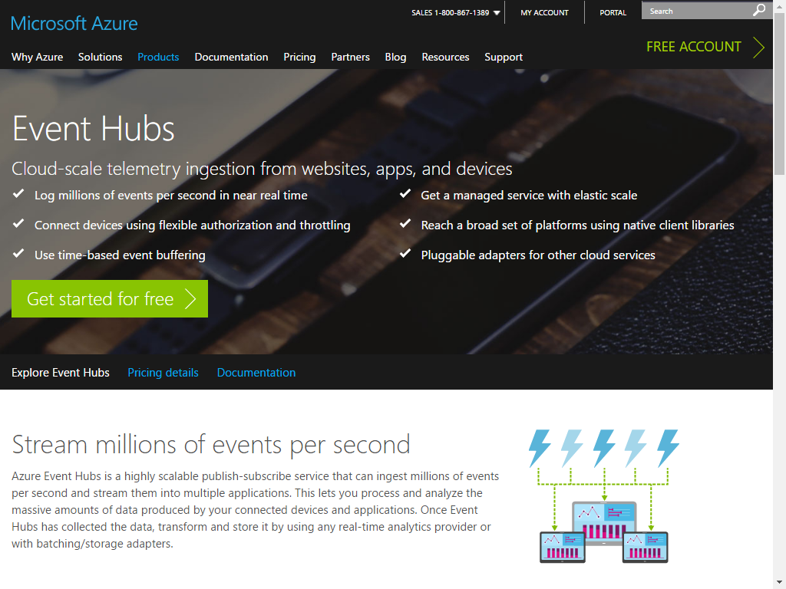
Azure Event Hubs
Stream millions of events per second
Azure Event Hubs is a highly scalable publish-subscribe service that can ingest millions of events per second and stream them into multiple applications. This lets you process and analyze the massive amounts of data produced by your connected devices and applications. Once Event Hubs has collected the data, transform and store it by using any real-time analytics provider or with batching/storage adapters.
https://aka.ms/ingenu2azure https://aka.ms/ingenu2azurecasestudy

Slide 18
Resource Group <name>group
Storage Account ingenustorage
App Service Plan ingenuplan
READ/WRITE
Function App ingenufunctions
Function IntellectRest2IoTHubJs
SQL Server ingenusql
Service Bus Namespace ingenubus
SQL Database
ingenudb
Event Hub
ingenualerts
SEND
OUTPUT
OUTPUT
Stream Analytics Job ingenujob
GET
AZURE
INPUT
RPMA to Azure
Architecture Diagram
IoT Hub ingenuhub
Ingenu Intellect Platform - REST or AMQP
INGENU
BACKHAUL
Ingenu RPMA Access Point
UPLINK
FIELD

Slide 19
Stream Analytics, SQL DB & Event Hubs
https://aka.ms/ingenu2azure https://aka.ms/ingenu2azurecasestudy

Slide 20
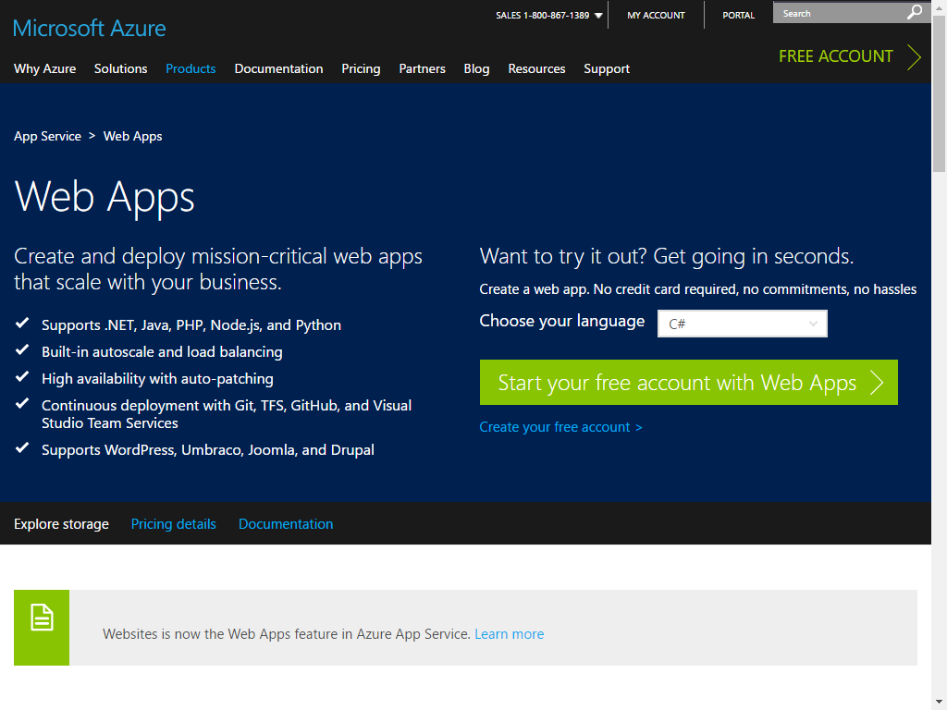
Azure Web Apps
Create and deploy mission-critical web apps that scale with your business.
Supports .NET, Java, PHP, Node.js, and Python
Built-in autoscale and load balancing
Continuous Deployment with Git, TFS, GitHub and Visual Studio Team Services
https://aka.ms/ingenu2azure https://aka.ms/ingenu2azurecasestudy

Slide 21
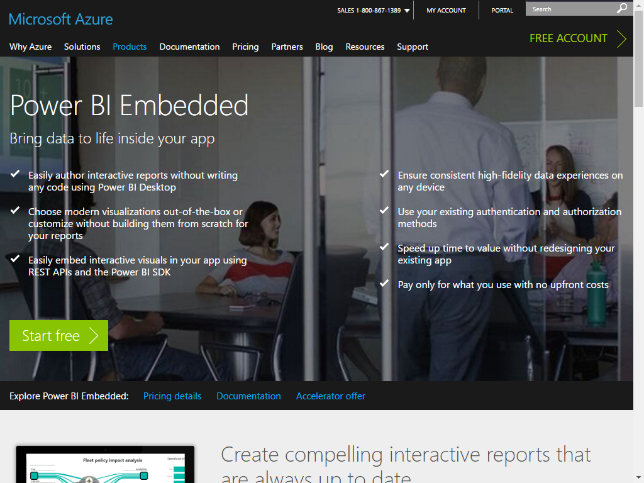
Power BI Embedded
Create compelling interactive reports that are always up to date
Power BI Embedded lets you create visually impactful and interactive reports against your application data in Power BI Desktop—without writing any code. Easily explore your application data through a freeform, drag-and-drop canvas and produce rich data models using formulas and relationships
https://aka.ms/ingenu2azure https://aka.ms/ingenu2azurecasestudy

Slide 22
Resource Group <name>group
Power BI Embedded Collection ingenucollection
Power BI Embedded Workspace Dynamic GUID
RENDER
Power BI Report Temperature Chart
Storage Account ingenustorage
App Service Plan ingenuplan
READ/WRITE
Function App ingenufunctions
GET
Web App ingenuweb
QUERY
Function IntellectRest2IoTHubJs
QUERY
Service Bus Namespace ingenubus
SQL Server ingenusql
SQL Database
ingenudb
Event Hub
ingenualerts
SEND
OUTPUT
OUTPUT
Stream Analytics Job ingenujob
GET
AZURE
INPUT
RPMA to Azure
Architecture Diagram
IoT Hub ingenuhub
Ingenu Intellect Platform - REST or AMQP
INGENU
BACKHAUL
Ingenu RPMA Access Point
UPLINK
FIELD

Slide 23
Web App and Power BI Embedded
https://aka.ms/ingenu2azure https://aka.ms/ingenu2azurecasestudy

Slide 24
Sending cloud-to-device messages
The last step in the demo.
We’ll act on the alerts that made it into our alerts event hub, and send alert messages back down to the device.
https://aka.ms/ingenu2azure https://aka.ms/ingenu2azurecasestudy

Slide 25
Resource Group <name>group
Power BI Embedded Collection ingenucollection
Power BI Embedded Workspace Dynamic GUID
RENDER
Power BI Report Temperature Chart
Storage Account ingenustorage
App Service Plan ingenuplan
READ/WRITE
Function App ingenufunctions
GET
Web App ingenuweb
QUERY
Function EventHub2IntellectRestJS
Function IntellectRest2IoTHubJs
QUERY
Service Bus Namespace ingenubus
SQL Server ingenusql
RECEIVE
SQL Database
ingenudb
Event Hub
ingenualerts
SEND
OUTPUT
OUTPUT
Stream Analytics Job ingenujob
POST
GET
AZURE
INPUT
RPMA to Azure
Architecture Diagram
IoT Hub ingenuhub
Ingenu Intellect Platform - REST or AMQP
INGENU
BACKHAUL
Ingenu RPMA Access Point
UPLINK
DOWNLINK
FIELD

Slide 26
Sending Cloud to Device Messages
https://aka.ms/ingenu2azure https://aka.ms/ingenu2azurecasestudy

Slide 27
Resource Group <name>group
Power BI Embedded Collection ingenucollection
Power BI Embedded Workspace Dynamic GUID
RENDER
Power BI Report Temperature Chart
Storage Account ingenustorage
App Service Plan ingenuplan
READ/WRITE
Function App ingenufunctions
GET
Web App ingenuweb
QUERY
Function EventHub2IntellectRestJS
Function IntellectRest2IoTHubJs
QUERY
Service Bus Namespace ingenubus
SQL Server ingenusql
RECEIVE
SQL Database
ingenudb
Event Hub
ingenualerts
SEND
OUTPUT
OUTPUT
Stream Analytics Job ingenujob
POST
GET
AZURE
INPUT
RPMA to Azure
Architecture Diagram
IoT Hub ingenuhub
Ingenu Intellect Platform - REST or AMQP
INGENU
BACKHAUL
Ingenu RPMA Access Point
UPLINK
DOWNLINK
FIELD

Slide 28
Azure IoT complete Backend
Build complete backend solution for your IoT Projects in
Microsoft Azure Bret Stateham
Bret.Stateham@Microsoft.com
@BretStateham
https://aka.ms/ingenu2azure

